Slide 1

Project 2 Feature Fuckery
An analysis

Slide 2
Models & Feature- Selection
Models:
4 nearest neighboors QDA Multiclass Logistic Regression

Slide 3
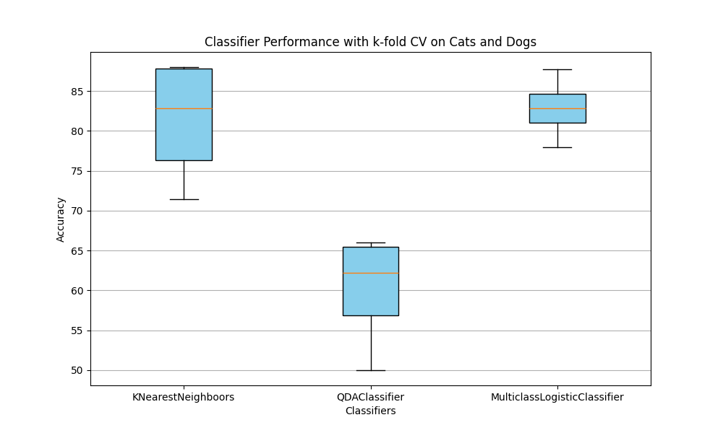
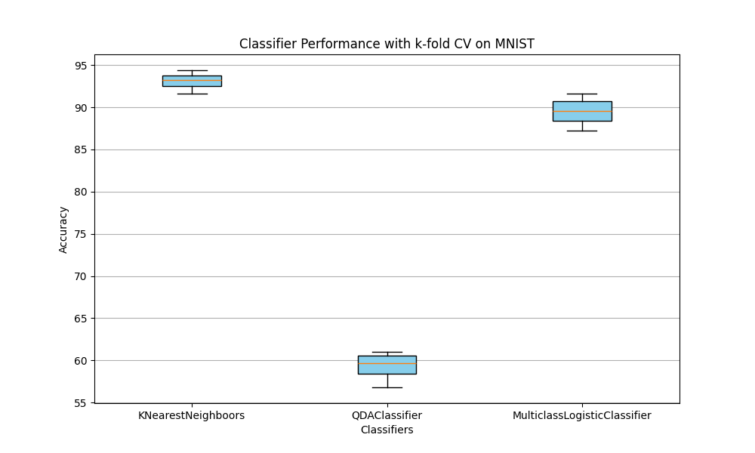
5FoldCV Perfomance Without Feature Selection

Slide 4
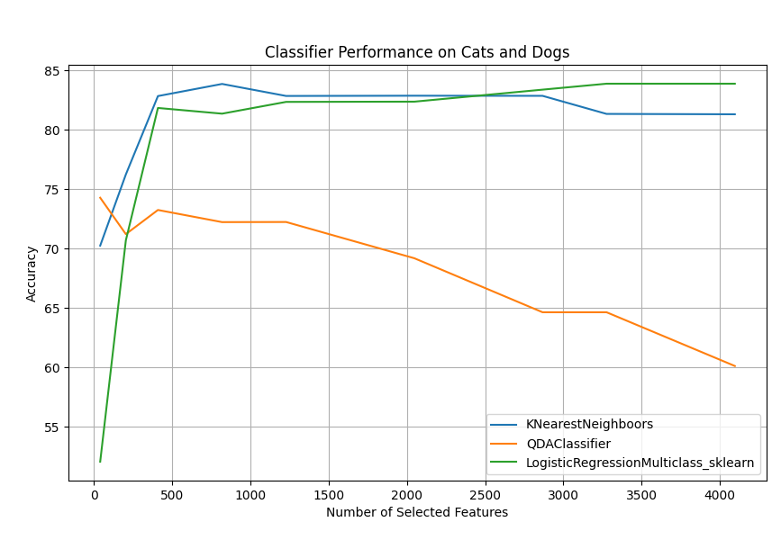
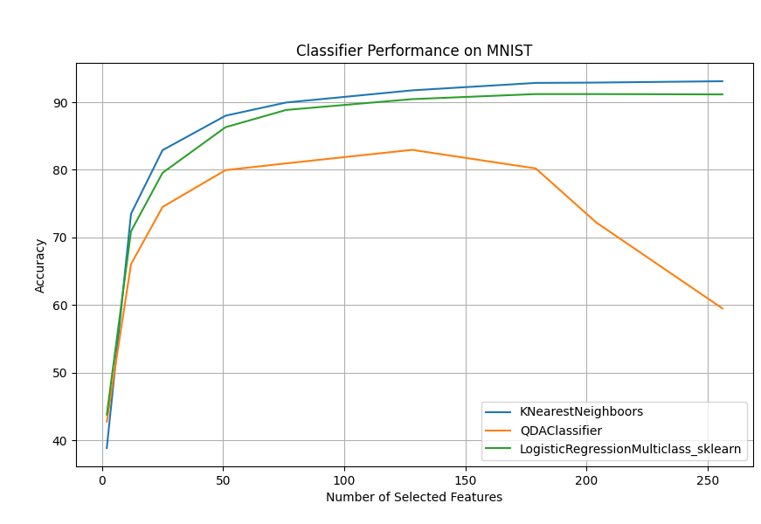
Classifier performance with Ftest Filter

Slide 5
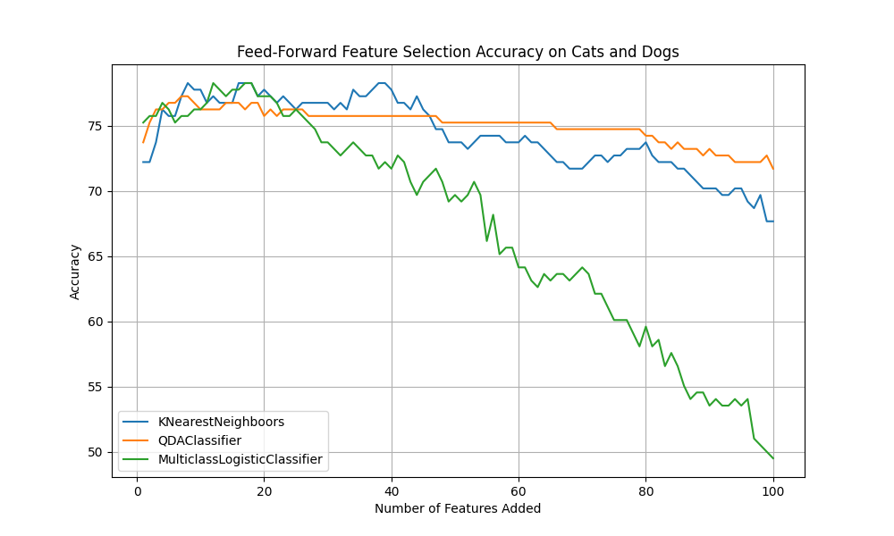
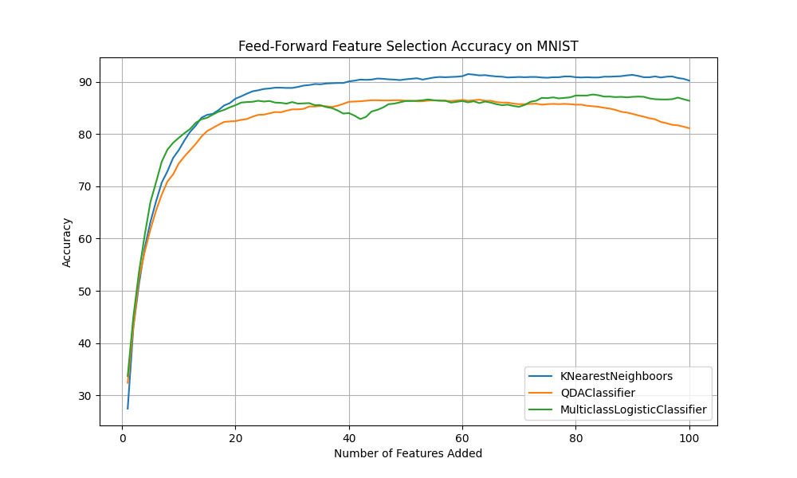
Ftest->FeedForward+ Classification
Cats And Dogs
Mnist Digits

Slide 6
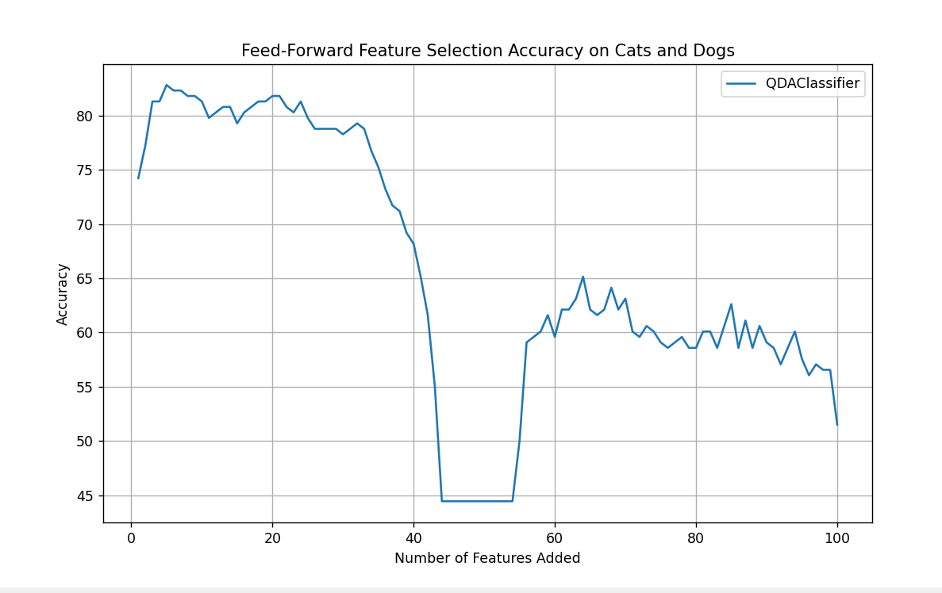
But sometimes

Slide 7
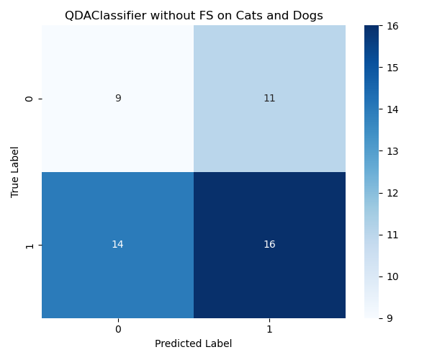
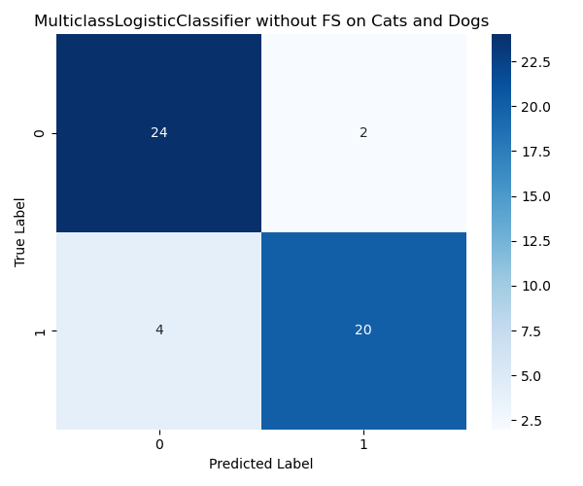
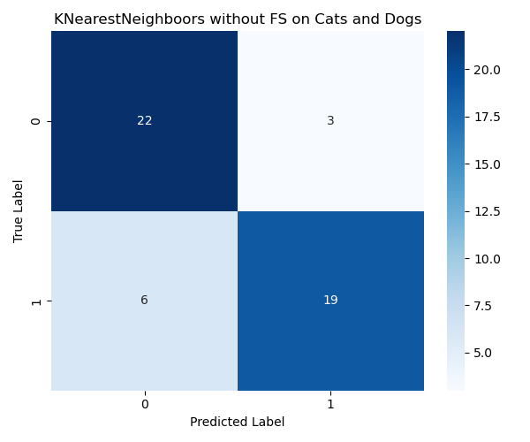
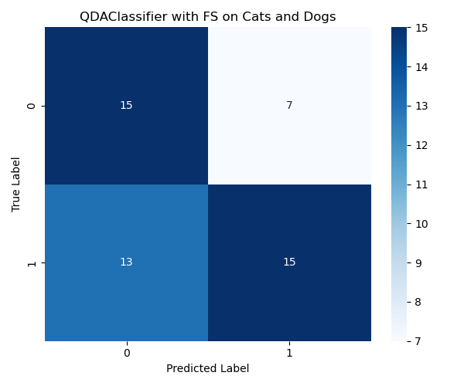
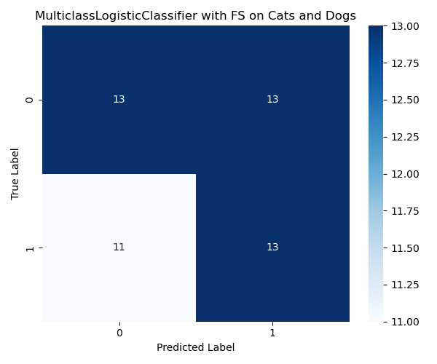
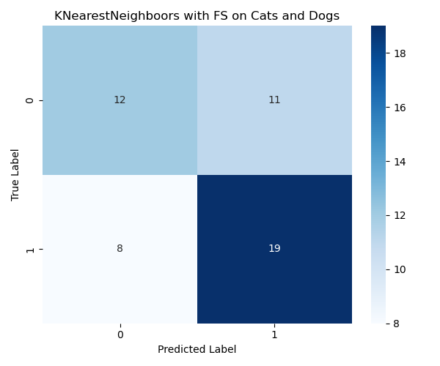
Confusion matric for Cats&Dogs
QDAlassifier without FS
MulticlassLogisticClassifier without FS
KNearestNeighbour without FS
QDAlassifier with FS
MulticlassLogisticClassifier with FS
KNearestNeighbour with FS

Slide 8
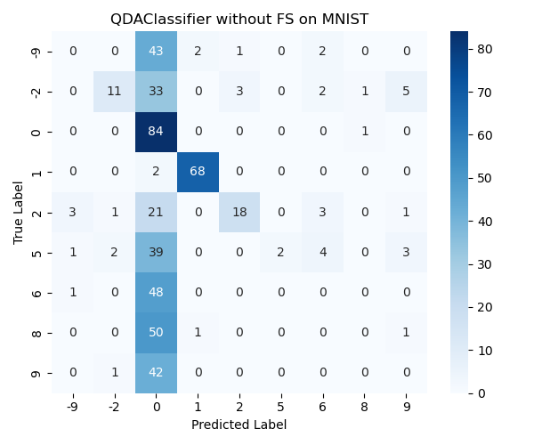
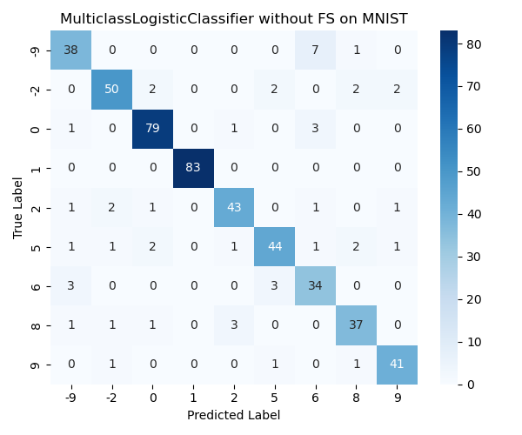
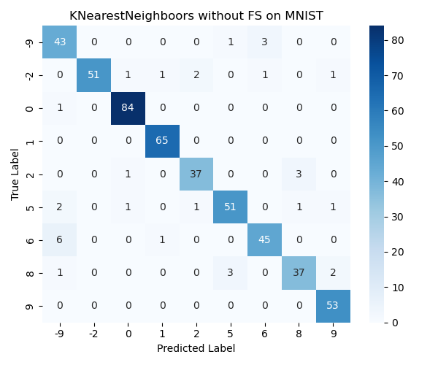
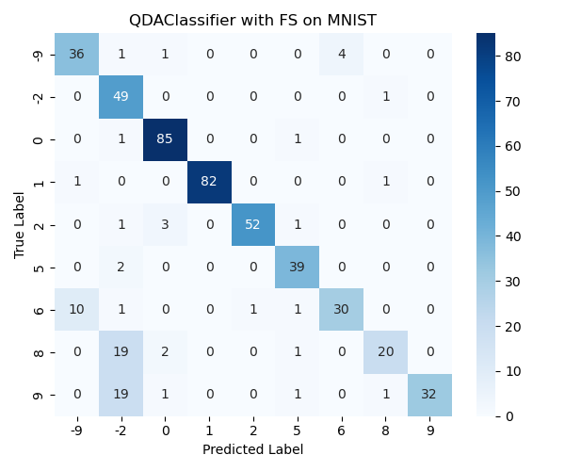
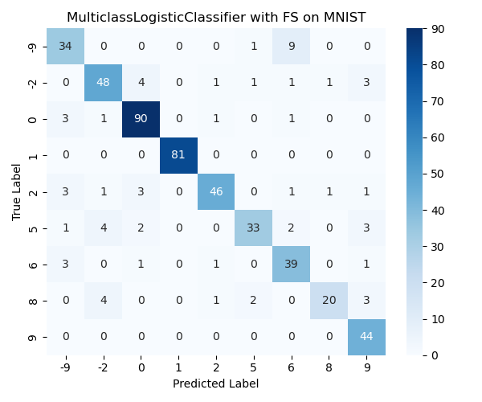
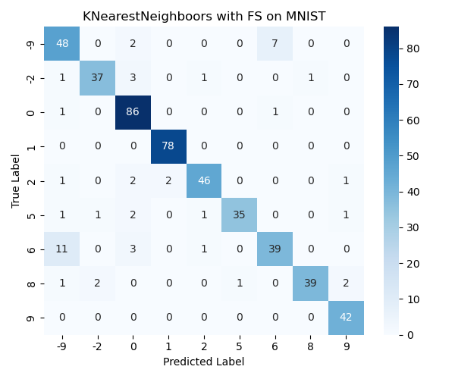
Confusion matrix for MNIST
QDAClassifier without FS
MulticlassLogisticClassifier without FS
KNearestNeighbours without FS
QDAClassifier with FS
MulticlassLogisticClassifier with FS
KNearestNeighbours with FS

Slide 9
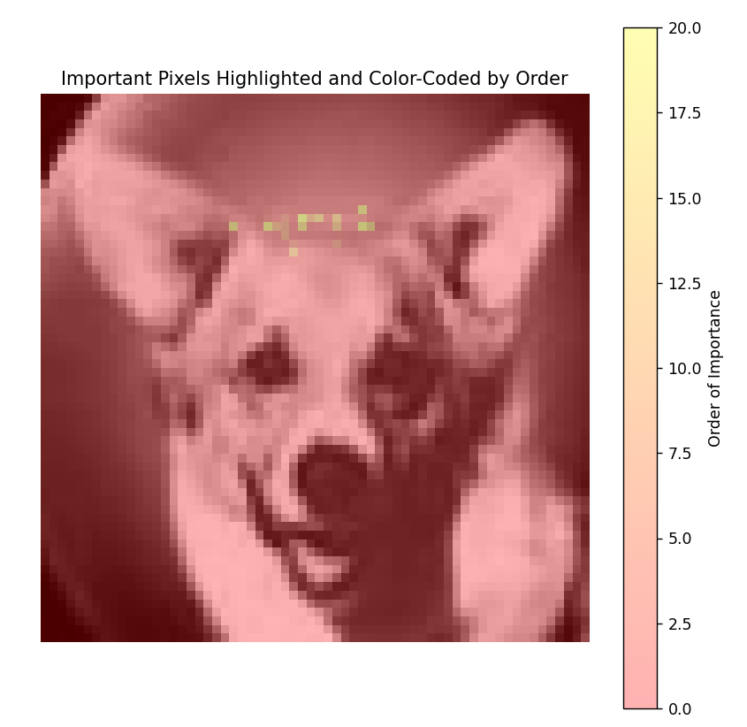

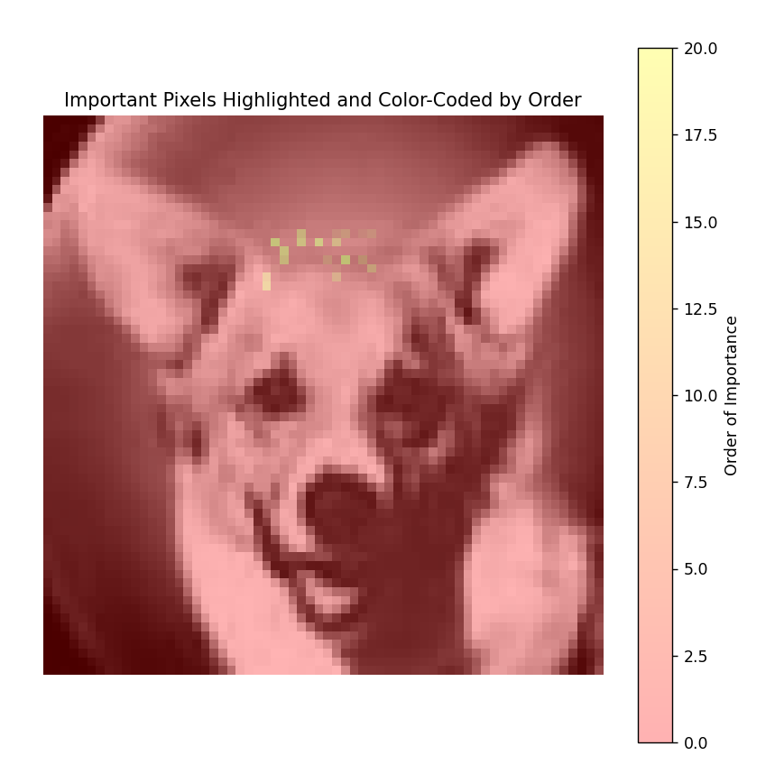
Important Pixels
Important Pixels highlighted
KNN
Logistic classifier
QDA

Slide 10
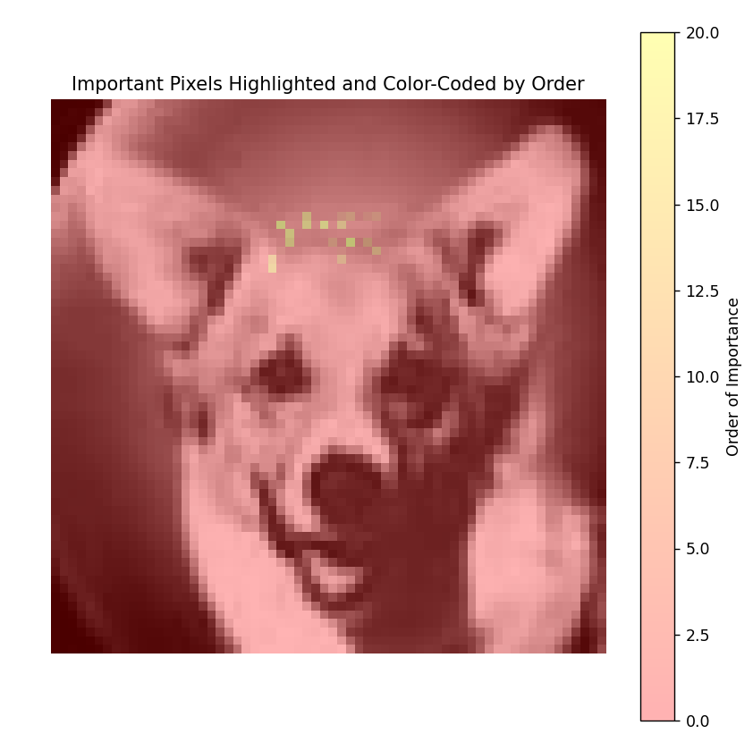
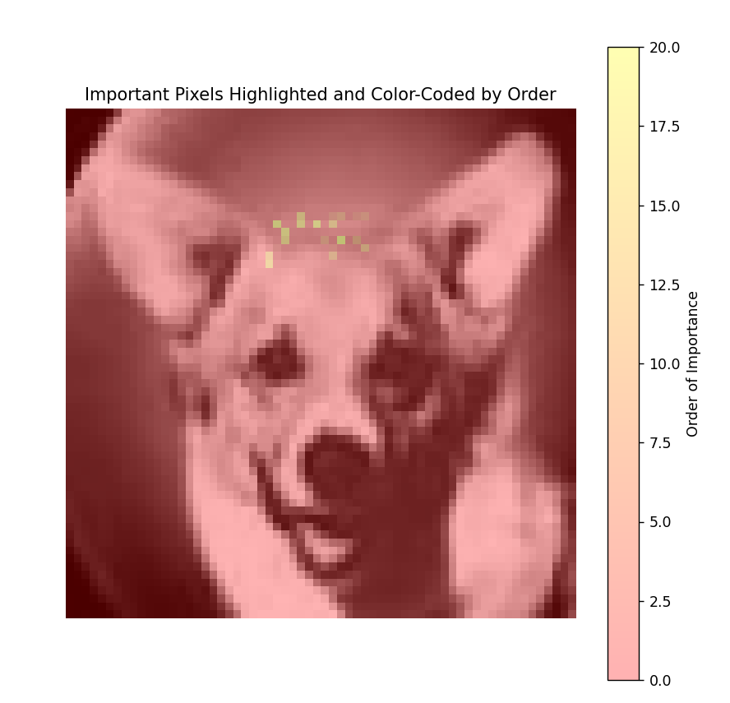
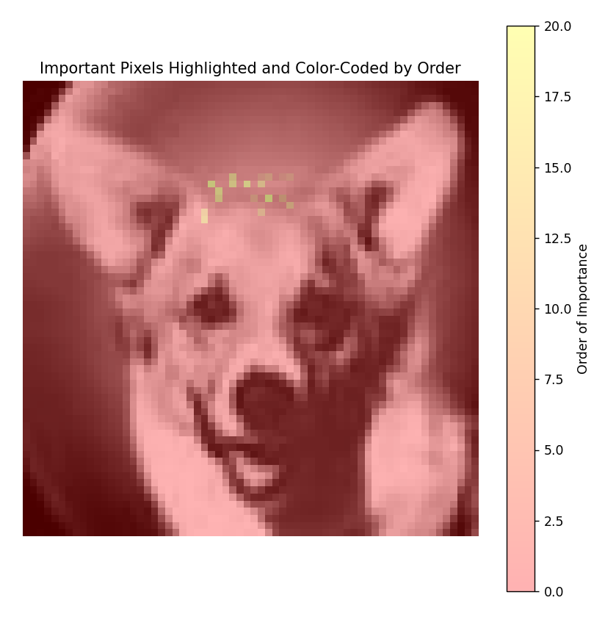
Same Pixels Every Time

Slide 11
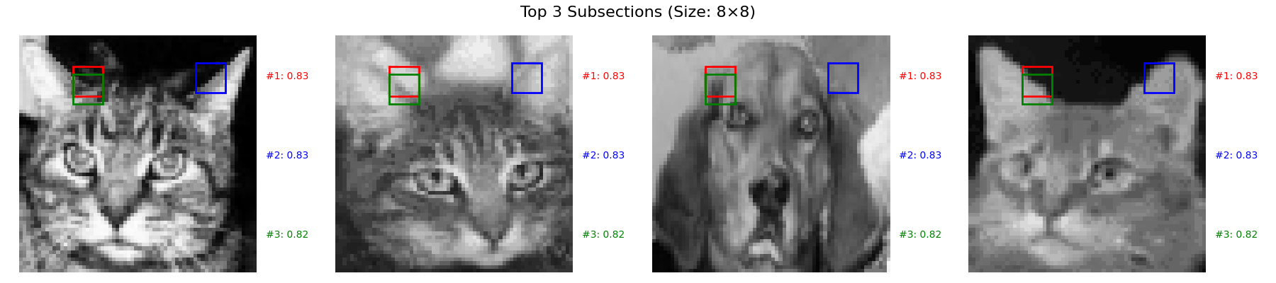
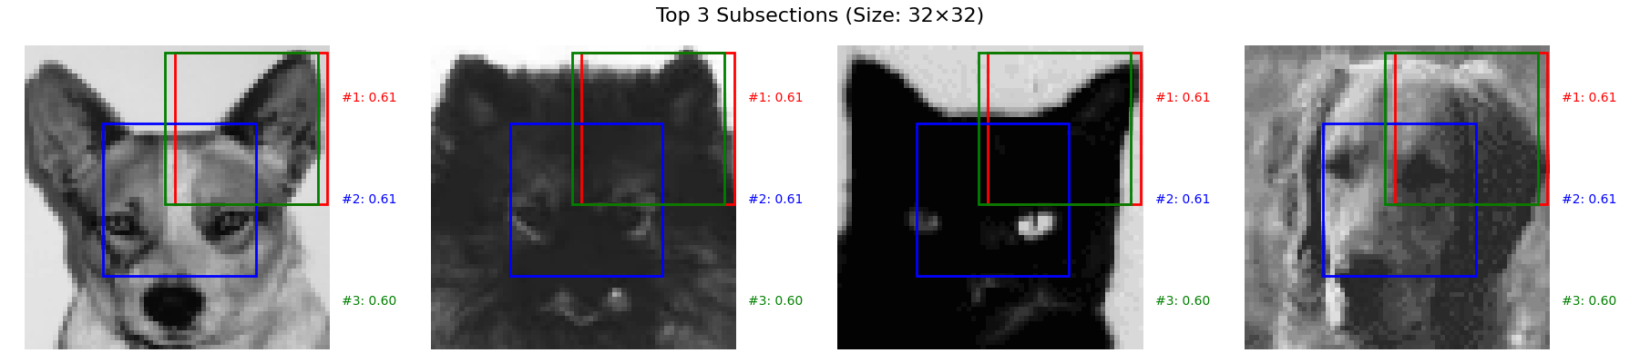
Comparing performance at best subsection
#1: 0.83
#2: 0.83
#3: 0.82
#1: 0.83
#2: 0.83
#3: 0.82
Square subsections of the images found
Different sizes of subsections
For each size approximately best section based on 5-fold CV found using simple seeking algorithm.
#1: 0.61
#2: 0.61
#3: 0.60
#1: 0.61
#2: 0.61
#3: 0.60

Slide 12
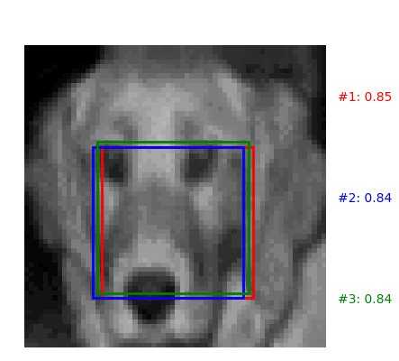
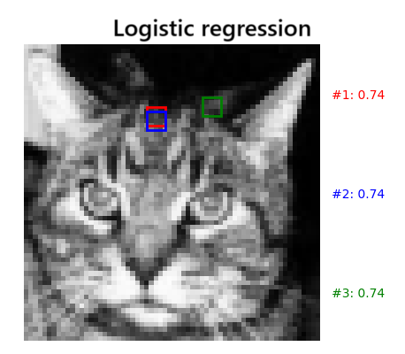
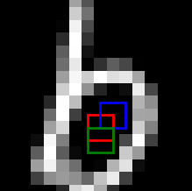
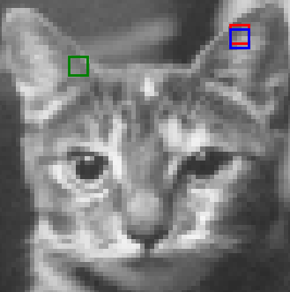
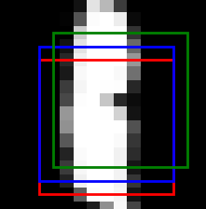
Which sections were best - highlights
#1: 085
#2: 0.84
#3: 0.84
Logistic Regression
For cats and dogs: similar results for all classifyers, even for QDA which yielded poor results.
Larger zooms favors face, closer zooms ears and "upper edge"
For mnist: Tends to go towards the middle.
#1: 074
#2: 0.74
#3: 0.74
#1: 0.5
#2: 0.5
#3: 0.5
KNN
#1: 078
#2: 0.77
#3: 0.76
#1: 08
#2: 0.8
#3: 0.8

Slide 13
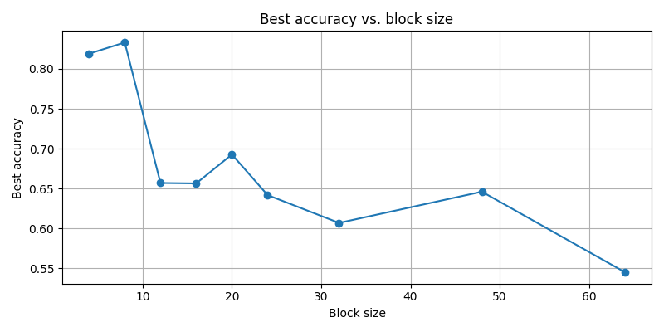
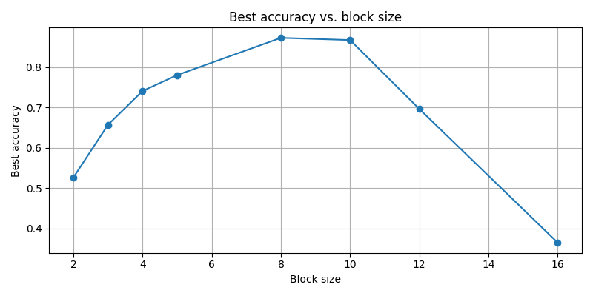
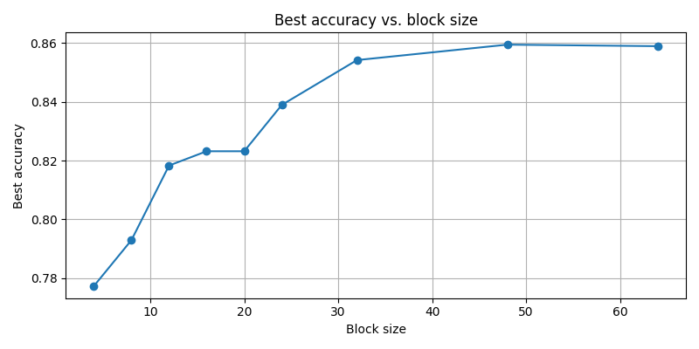
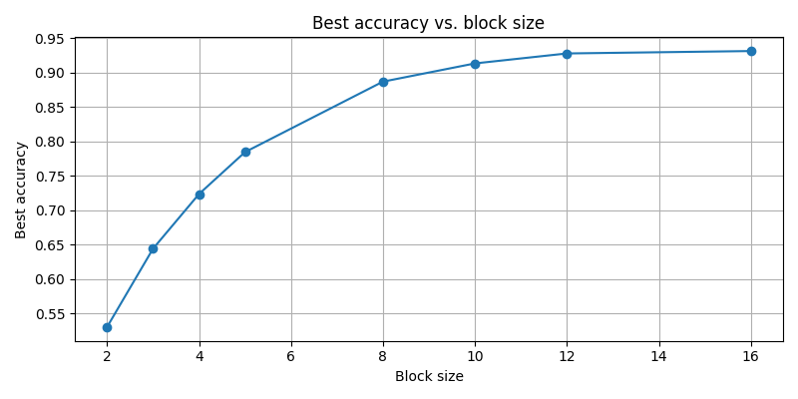
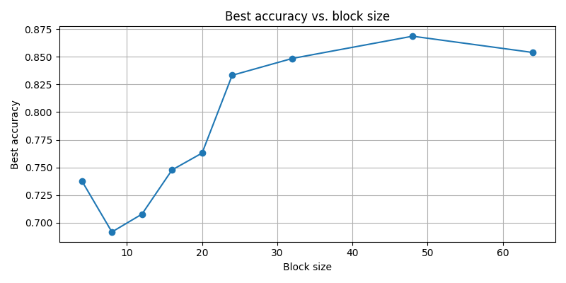
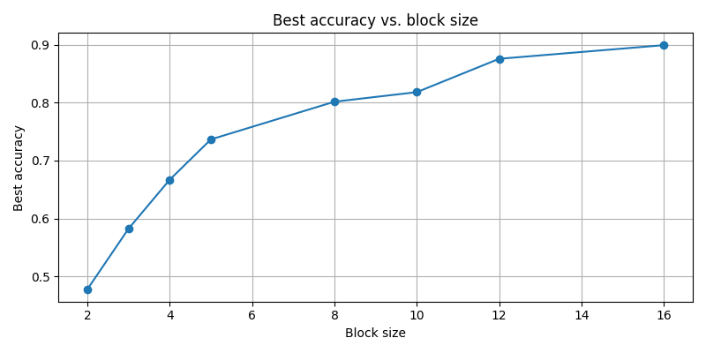
Subsections:
Cats and dogs:
Mnist:
QDA
KNN
Logistic

Slide 14
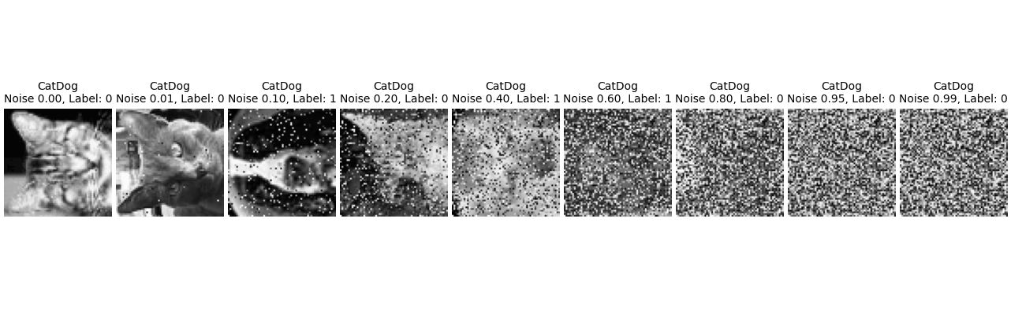
Contamination
Uniformally disributed black and white noise applied randomly to certain percenage of pixels
Same noise applied to all images in each run
accuracy determined by 5-fold CV for all 3 classifyers.

Slide 15
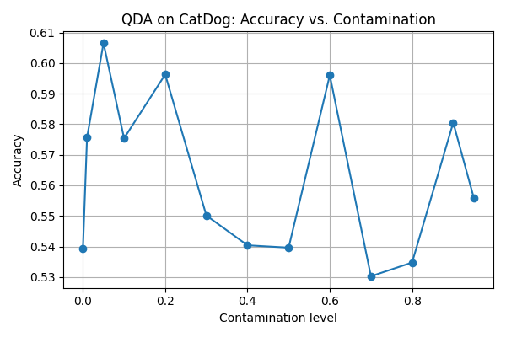
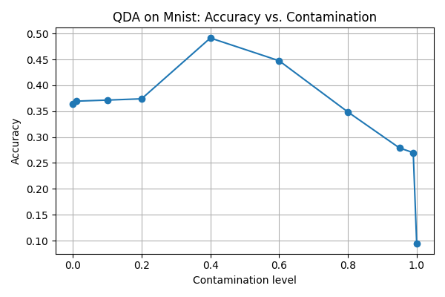
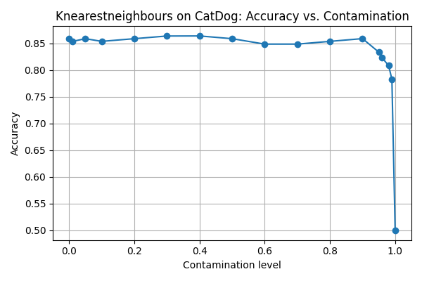
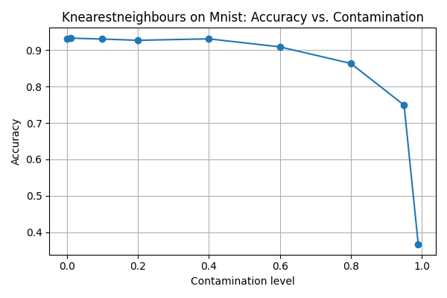
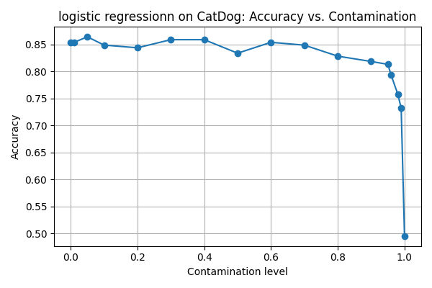
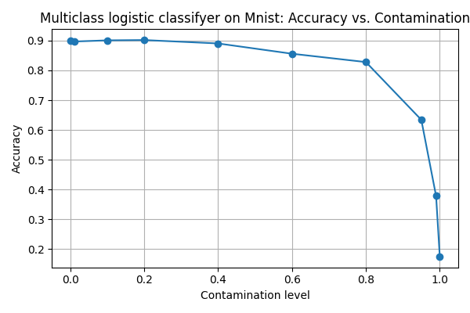
contamination:
Cats and dogs:
Mnist:
QDA
KNN
Logistic

Slide 16
Questions?
Thank you for your time!

